Slide 1
PERFECT Case Studies Demonstrating Order of Magnitude Reduction in Power Consumption
David K. Wittenberg, Edin Kadric, Andre DeHon, Jonathan Edwards, Jeffrey Smith, and Silviu Chiricescu

Slide 2
The Problem – Wide Area Motion Imaging (WAMI)
Want real-time data
High resolution - 368 Cell phone cameras
1.8 Gpixels @ 10 Hz
Airborne
Limited bandwidth to ground
Limited power
Notes:
Classic image processing problem
Good example: numeric computation, arrays -- No floating point
More detail in Nova broadcast – Google Nova BAE ARGUS to find it

Slide 3
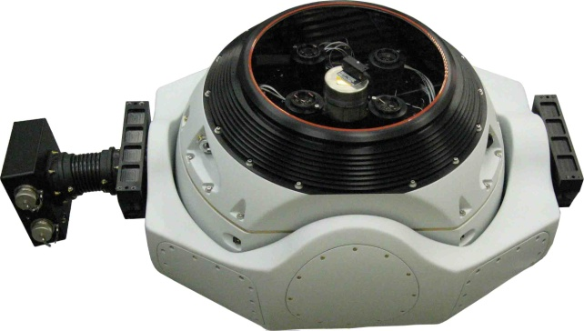
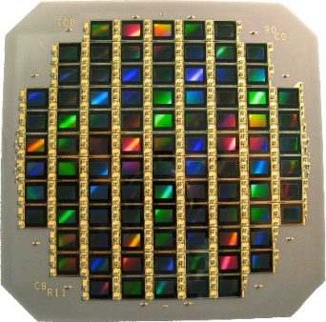
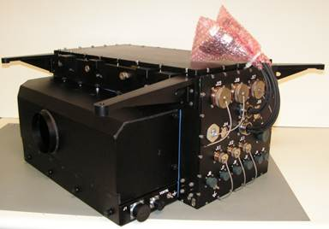
ARGUS-IS System Components
ARGUS-IS system components. Left: sensor in 25” gimbal; Right: CFPA with 92 5 MPixel FPAs.
ARGUS-IS ruggedized airborne processor
Notes:
Gimbals more than 2 feet across.

Slide 4
Our Solution
Lower Voltage
Light-Weight Checks
Explore Parallelism
Continuous Hierarchy Memory
Notes:
4 techniques. Lower voltage is well known, but leads to more errors, and slower performance, we fix that with Light Weight Checks and parallelism. Continuous Hierarchy Memory is a general technique for FPGAs, which has not been used before.

Slide 5
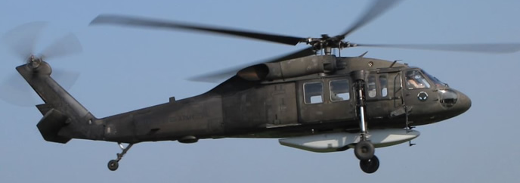
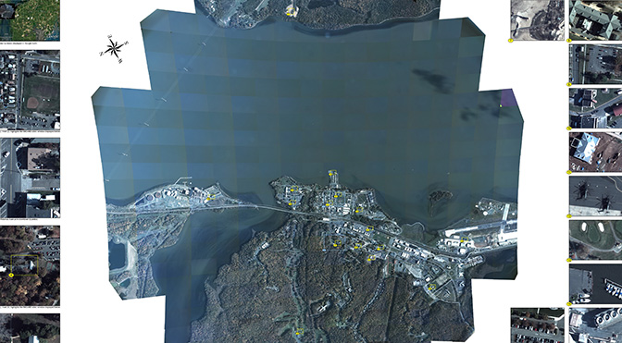
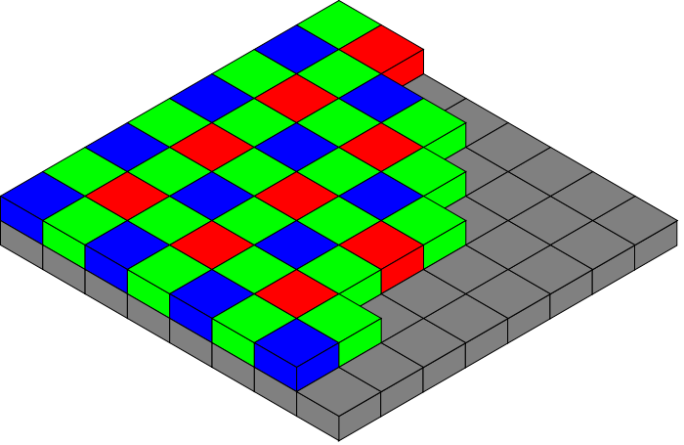
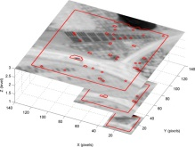
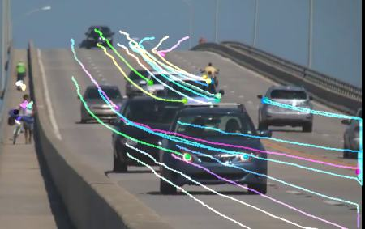
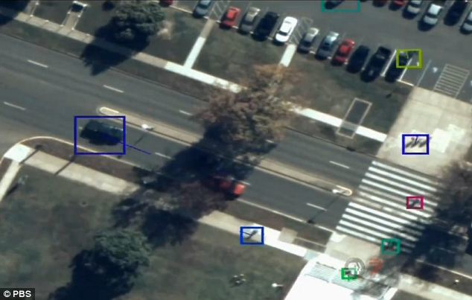

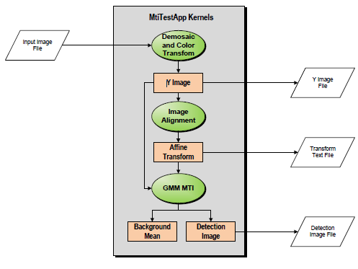
ARGUS-IS context drives PERFECT energy improvements
Measure energy on the ARGUS-IS WAMI pipeline components
Raw image
Demosaicing
Registration
Motion Detection and Tracking
Final Image
Debayer
Lucas-Kanade
Gaussian Mixture Model
Measure energy on the PRACTICE LEARN WAMI implementation
4
Notes:
Complete WAMI flow
LK functional and connected
- describe Lucas-Kanade
Worked out meaningful comparison with Argus → Highly optimized custom FPGA vs. highly optimized CUDA architectures with same data and algorithms
Approach
Use same dataset that was also used multiple technologies -- UPSIDE
Use same nominal specifications for actual flight tests (e.g. cooling budgets, power supply overhead, etc.)
_____________________
Real measurements against real ARGUS testbed starting with Blackhawk derived images
Demosaic color
LK+, georeg
Frame-frame change
Only PERFECT performer with a full implementation

Slide 6
Parallel
Optimized
Design
Demosaicing
Registration
Motion Detection and Tracking
512×512 Image
 |  | Debayer | LK | GMM | WAMI
 | PEs | 1 | 4 | 8 | (4,4,4)
 | Ops/Cycle | 20 | 220 | 680 | 360
 | Area (cm²) | 0.0046 | 0.33 | 0.2 | 0.55
0.7V Vdd | Throughput (fps) | 540 | 150 | 1600 | 150
 | Efficiency (Gops/W) | 740 | 280 | 910 | 340
0.5V Vdd | Throughput (fps) | 110 | 30 | 320 | 50
 | Efficiency (Gops/W) | 1500 | 560 | 1800 | 680
Notes:
Hard core data is from 512x512, but it’s parallel (and linear, and decomposable), so these metrics should hold for larger image. It’s a good estimate for larger image w/out brute force running the larger image.
Full WAMI consumes little area
Vdd is nominal operating voltage
14nm process
Architecture point chosen for optimal parallel kernel
each kernel achieves the best energy efficiency at different parallelism level. Trade off between them, we chose 4 elements for each kernel.
Increasing memory size and #’s still hold for different architectures
The numbers quoted for the kernels/application assume the same architecture (i.e. mem size). The size of the memory is supposed to be for the best architecture shown on the previous slide, which happens to be 128Kb memories placed every 2 columns for all kernels. The answer would have probably been different between the different kernels if we had pushed this to a higher PE count and lower memory sizes.

Slide 7
Continuous Hierarchy Memory
Notes:
* Energy of accessing a memory ~ sq root of mem size so excessively large memories increase the energy cost.
* Excessively small memories – long wires dominate energy
CHM minimizes the energy cost by dividing memory blocks into several smaller blocks, allowing the designer to use an optimal number of memory blocks.
put most often accessed memory closer.
* One can further optimize power consumption by choosing the appropriate-size memory blocks when the FPGA is made.

Slide 8
Notes:
S- voltage scaled to near threshold, but that increases required time too much, so we only reduce voltage from .95V to .75V
22 nm process

Slide 9
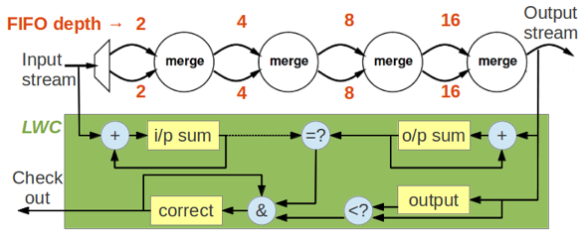
Light Weight Checks
Example: Sorting vs. checking that it is sorted
Not needed in many imaging algorithms, as they iterate until errors are small enough
Notes:
Note that even with low voltage, we only have a few errors per billion hours of computation, so dealing with errors takes negligible total time
mulitple classes of lightweight checks -- LWCs are not always possible, must be hand-crafted for each problem. Taylor series expansion – check first few terms

Slide 10
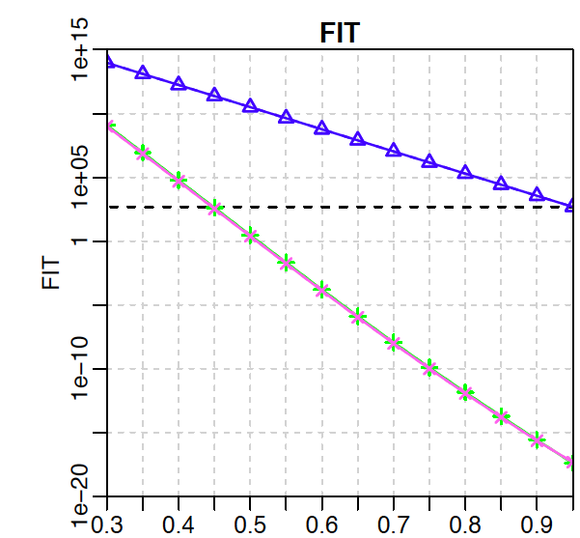
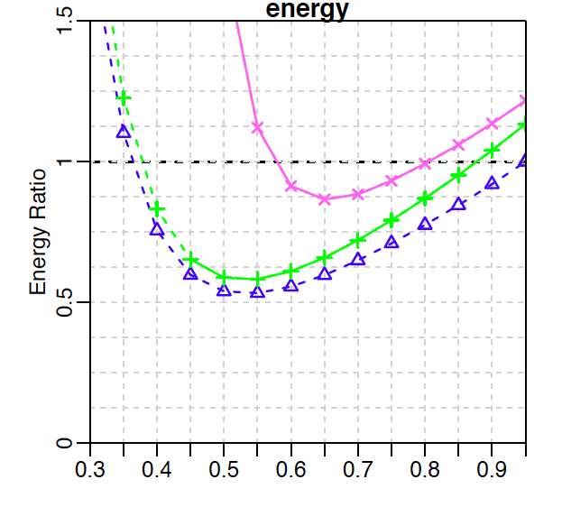
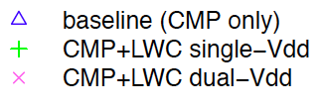
Differential vs. Single Voltage (22nm example)
Vdd
Vdd
Notes:
Energy ratio = energy consumption/ energy w/out LWC running at nominal voltage
the Vdd is reduced from 0.95V to 0.5V. The high voltage is maintained at the same level as the Vdd. Low voltage for pink curve is the one shown on the X-axis. High voltage remains at 0.95V.
FIT is Failure In Time
No difference between high and low voltage in bit rate
Blue on right is reference for full voltage
Also on the left curve, note that sometimes the curve is solid, sometimes it is dashed. The solid curves meet or exceed the unprotected baseline at full voltage. The dashed curves do not. The green curve is the interesting one that is partly solid (all the way down to and past the minimum energy point), while the blue and pink curves are either solid (pink) or dashed (blue).
Reliability dominated by 2 errors in low-voltage logic;
High voltage checker - Reduces likelihood of checker missing single error in low-voltage logic; Chances of that happening is lower than two errors in logic
LWC checker small compared to computation so it is more reliable than the CMP at the same voltage

Slide 11
PERFECT Results and Comparison with ARGUS
PERFECT Simulated Output for WAMI Pipeline
  Scaled 512x512 pixel 5 Mpixel and further scaled to achieve 3000 frame run
    7 nm process technology assumed as best-case
  Varying Vdd and Mem-size led to optimized GOPS / W
    Vdd = 0.7, Mem size = 64k
Key Results:
  237X GOPS/W increase even with memory intensive pipeline
  Performed 4X more operations due to differences in implementation
Comparison of ARGUS-IS GPU and PERFECT output
Notes:
ARGUS - Summary Conclusions
Significant memory interaction leads to memory bound pipeline
1.9 GOPS / W total → fraction of 18 GFLOPS/W theoretical
Only a fraction of energy is used for pure calculation (est. 10%)
PERFECT
Significant gains achievable with PERFECT in realistic setting
Difficult to realize immediate gains in ARGUS-IS since most power isn’t calculation-related; however, results can drive need for system improvement

Slide 12
TAILWIND: PERFECT gives 6-15X Improvement
 | TAILWIND SYSTEM |  | PERFECT SYSTEM
 | Image Registration (SLAM) | Motion Detection (RFD) | Image Registration (LK) |  | Motion Detection (GMM)
 |  |  | STD | CHM | STD | CHM
Energy/Frame (mJ) | 752 | 237 | 175 | 129 | 19 | 14
Time/Frame (ms) | 253 | 83 | 444 |  | 37
Motion Detection – PERFECT kernel consumes ≈ 15X less energy than the TAILWIND kernel
Image Registration – PERFECT kernel consumes ≈ 6X less energy than the TAILWIND kernel
Notes:
Instrumented TAILWIND with functionally equivalent PERFECT kernels provided by the TAV team
Image Registration
TAILWIND – SLAM kernel
PERFECT – LK
Change Detection
TAILWIND – Robust frame differences (based on traditional frame differences algorithm + interval based GMM)
PERFECT – traditional GMM with 5 background distributions
PERFECT used GMM to get 2 ½ D not 3 D, so it’s a harder problem
Tactical Aircraft to Increase Long Wave Infrared Nighttime Detection (TAILWIND)
Source code available for instrumentation
Flew multiple test missions on-board a Twin Otter airplane; Running on Intel-based servers drawing 1100W each
Instrumented TAILWIND with functionally equivalent PERFECT kernels provided by the TAV team;
Measured system-level impact -- details in paper
The TailWind sw was run on a Intel Core i5-4250U Processor (4th generation ultra-low-power Haswell micro-architecture, 22 nm).
The PERFECT data was generated using a single PE/kernel and a specific architecture targeting a 22nm lithography node. As we perform an architectural sweep and increase the parallelism (e.g. multiple PEs/kernel) we expect increased energy efficiency from the PEREFCT system – which is consistent with previously reported results.

Slide 13
Summary
Exceeded PERFECT energy efficiency goals by up to 10x (440-680 Gops/W) on common set of Wide Area Motion Imagery (WAMI) kernels
The projected Argus power consumption reduction enables:
  Airborne, real-time 3D situational awareness to the warfighter along with:
    Miniaturization of 3D mapping technology currently housed in multiple server racks
    Increased the flight mission time and track detection accuracy with improved data compression in manned flights
  Autonomous threat detection, tracking and multi-sensor fusion
Designed a novel FPGA based architecture that combines ultra low power operation with high reliability
  Optimize the substrate and design mapping to minimize communication energy

Slide 14
Acronyms Used
ARGUS Autonomous Real-time Ground-Ubiquitous Surveillance-Imaging System
CHM Continuous Hierarchy Memory
FIT Failures In Time
FPGA Field Programmable Gate Array
GMM Gaussian Mixture Model
LEARN Low-Energy Architecture of Reconfigurable Nodes
L-K Lucas-Kanade
LWC Light Weight Checks
PERFECT Power Efficiency Revolution for Embedded Computing Technology
RANSAC RANdom SAmple Consensus
RFD Robust Frame Differences
SLAM Simultaneous Location And Mapping
TAILWIND Tactical Aircraft to Increase Long Wave Infrared Nighttime Detection
UAV Unmanned Aerial Vehicle
WAMI Wide Area Motion Imagery

Slide 15
BACKUP

Slide 16
Minimal
Streaming
Design
Demosaicing
Registration
Motion Detection and Tracking
Fully functional pipeline
512×512 Image
 |  | Debayer | LK | GMM | WAMI
 | PEs | 1 | 1 | 1 | (1,1,1)
 | Ops/Cycle | 20 | 55 | 85 | 90
 | Area (cm²) | 0.0046 | 0.13 | 0.034 | 0.17
0.7V V_{dd} | Throughput (fps) | 540 | 58 | 430 | 57
 | Efficiency (Gops/W) | 740 | 250 | 650 | 300
0.5V V_{dd} | Throughput (fps) | 110 | 12 | 85 | 11
 | Efficiency (Gops/W) | 1500 | 500 | 1300 | 600
Notes:
Minimum streaming design is enough to gets bytes flowing – no spatial parallelism
LK fully functional (vs TAV versions)– took most time and operations
Small area compared to chip
Each algorithm and system surpassed throughput
Scaled to .5v – not optimum but 1st functional point
Fully functional WAMI
Can instantiate multiple copies of each kernel, with lower total energy consumption
14 nm process

Slide 17

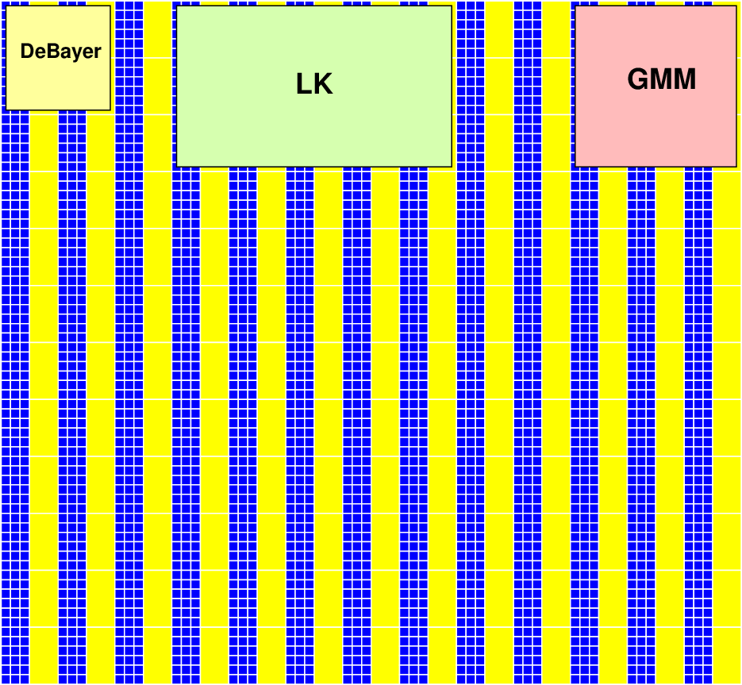
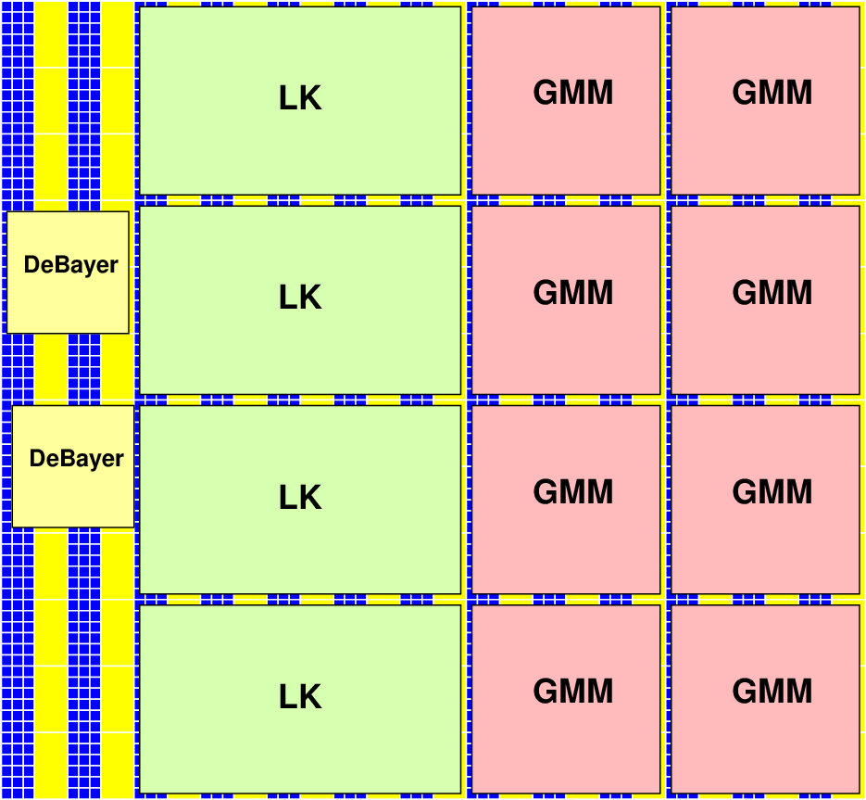
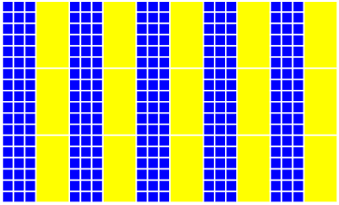
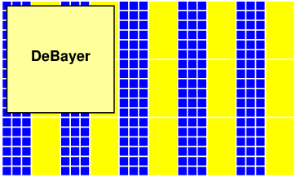
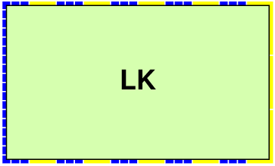
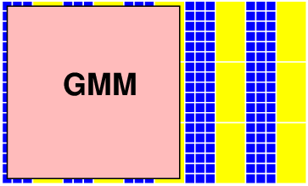
WAMI on FPGA
Notes:
One of each doesn’t fill the chip
What is optimum # of PEs to minimize energy and maximize throughput
Blue logic CLB (config logic blocks – 4 LUTs /CLB), yellow memory
Can only simulate FPGAs of a certain size
Cartoonish but accurate size of the kernels relative to each other
As many kernels as we need to meet energy throughput as we needed
LK is small w.r.t. 7 nm

Slide 18
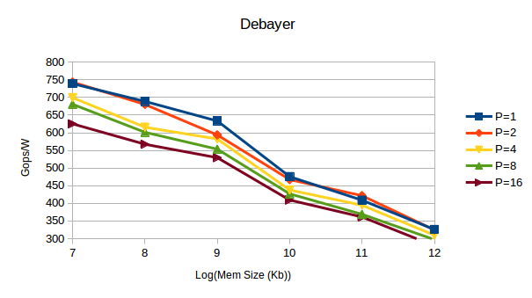
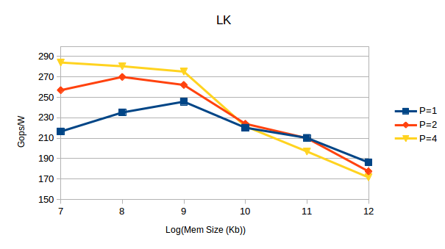
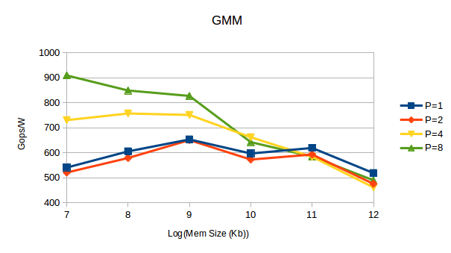
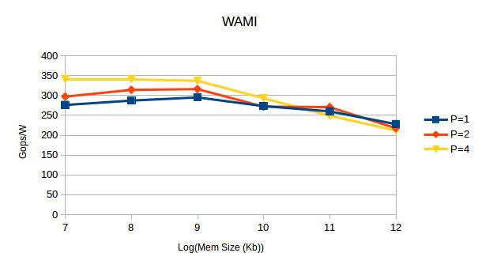
Optimizing Parallelism
DeBayer
LK
GMM
L
512×512
Image
Notes:
Can only simulate up to 4 for LK
GPP sim and VPR crash
WAMI push to 4 PEs and fit everything (also limit)
Optimal point is different/kernel
Smaller memory is better … to a point – help pick granularity of memory

Slide 20
Energy reduction techniques*
Use low-power technology
Voltage scaling
Use T-gates or gate-boosting (GB) instead of pass-T w/ level restorer
Use dual-Vdd
Power gating
* Edin Kadric “Energy reduction through voltage scaling
and lightweight checking”, PhD. Thesis.
Notes:
Voltage scaling – what are HP and LP

Slide 21
TAILWIND System Level Metrics
Data Set | System Level Metric | SLAM + RFD | LK + RFD | SLAM + GMM
Quantico Scene 1 | P(vehicle detection) | 0.9 | 0.53 | 0.5
 | P(dismount detection) | 0.64 | 0.38 | 0.46
 | False alarm/minute | 1.35 | 103 | 163
 | P(tracking vehicle) | 0.3 | 0.1 | 0
 | P(tracking dismount) | 0.33 | 0.14 | 0.14
Quantico Scene 2 | P(vehicle detection) | 0.82 | 0.89 | 0.3
 | P(dismount detection) | 0.52 | 0.71 | 0.25
 | False alarm/minute | 8.9 | 149 | 124
 | P(tracking vehicle) | 0.42 | 0.25 | 0
 | P(tracking dismount) | 0.44 | 0.28 | 0.1
Quantico Scene 3 | P(vehicle detection) | 0.85 | 0.54 | 0.24
 | P(dismount detection) | 0.6 | 0.42 | 0.19
 | False alarm/minute | 4.1 | 117 | 126
 | P(tracking vehicle) | 0.15 | 0.13 | 0.03
 | P(tracking dismount) | 0.21 | 0.09 | 0.27
TAILWIND
  Fine-tuned parameters for the different kernels
PERFECT
  Dismounts are at granularity of a few pixels which is more than the difference between consecutive frames – large false alarm rates
  GMM has lower levels of accuracy than RFD
  Varying the GMM parameters (e.g. learning rate and # of background distributions) resulted in minor changes to the overall system metrics
Notes:
RFD – robust frame differences
Bar to track is high needed for a few seconds of data – better tracking of vehicles

Slide 22
ARGUS-IS Public Release Poster

Slide 23
References from PERFECT project
  Edin Kadrik, David Lakata and André DeHon. “Impact of Memory Architecture on FPGA Energy Consumption”, FPGA’15, Monterey, California, USA, Feb 22-24, 2015, http://ic.ese.upenn.edu/pdf/meme_fpga2015.pdf.
  Benjamin Gojman, Sirisha Nalmela, Nikil Mehta, Nicholas Howarth, and André DeHon, “GROK-LAB: Generating Real On-chip Knowledge for Intra-cluster Delays using Timing Extraction”, ACM Transactions on Reconfigurable Technology and Systems (TRETS) , Volume 7, Number 4, DOI: 10.1145/2597889, December, 2014.
  E. Kadric, K. Mahajan, A. DeHon, "Kung Fu Data Energy—Minimizing Communication Energy in FPGA Computations", IEEE Symposium on Field-Programmable Custom Computing Machines (FCCM), May 11–13, 2014
  E. Kadric, K. Mahajan, A. DeHon, "Energy Reduction through Differential Reliability and Lightweight Checking", FPGA’14, February 26–28, 2014, Monterey, California, USA.
  Feng Liu, Soumyadeep Ghosh, Nick P. Johnson, David I. August. “CGPA: Coarse-Grained Pipelined Accelerators”, Design Automation Conference (DAC), 2014 51st ACM/EDAC/IEEE, 1-5 June 2014, San Francisco, CA, http://dl.acm.org/citation.cfm?doid=2593069.2593105
  Andre DeHon, “Fundamental Underpinnings of Reconfigurable Computing Architectures”, accepted for publication in the Proceedings of the IEEE , Volume 103, Issue: 3, DOI: 10.1109/JPROC.2014.2387696, March 2015, http://ieeexplore.ieee.org/xpl/articleDetails.jsp?arnumber=7086421
  Feng Liu, Heejin Ahn, Stephen R. Beard, Taewook Oh, and David I. August, “DynaSpAM: Dynamic Spatial Architecture Mapping using Out of Order Instruction Schedules”, Proceedings of the 42nd International Symposium on Computer Architecture (ISCA), ISBN 978-1-4503-3402-0/15/06, Portland, OR, USA, June 13-17, 2015.
  Edin Kadrik, David Lakata and André DeHon, "Impact of Parallelism and Memory Architecture on FPGA Communication Energy", ACM Transactions on Reconfigurable Technology and Systems, Vol. 9, to be published date: 2016. 0/15/06, Portland, OR, USA, June 13-17, 2015.
  “Demonstration of Applicability of PERFECT/PRACTICE Technology to TAILWIND Processing”, BAE Systems Technical Report for DARPA PERFECT Program
  “Demonstration of Applicability of PERFECT-PRACTICE Technology to ARGUS‐IS Processing”, BAE Systems Technical Report for DARPA PERFECT Program

