Slide 1
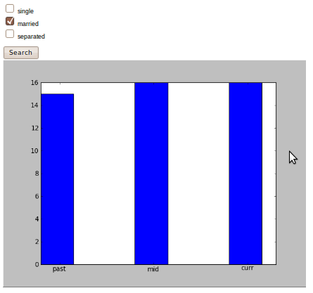
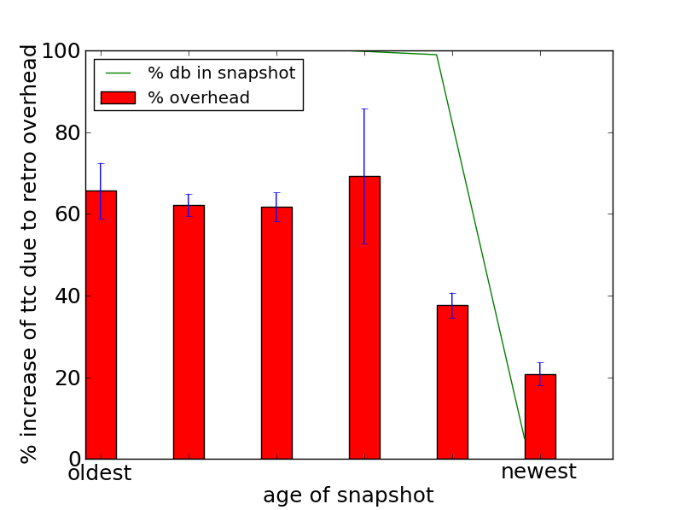
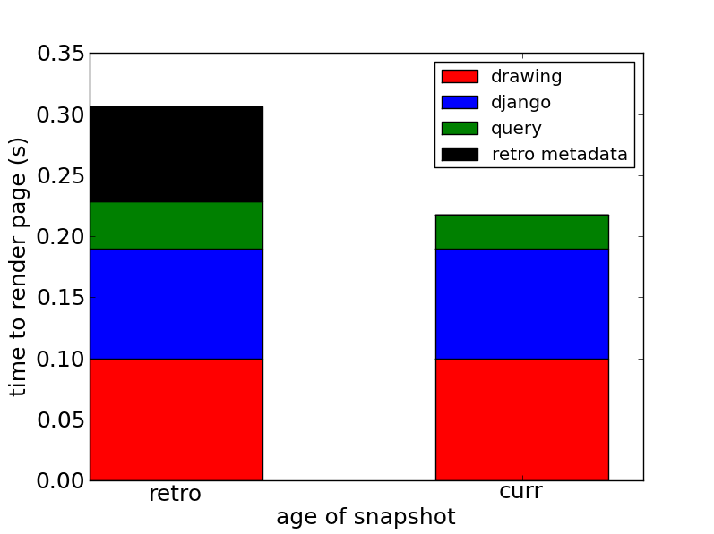
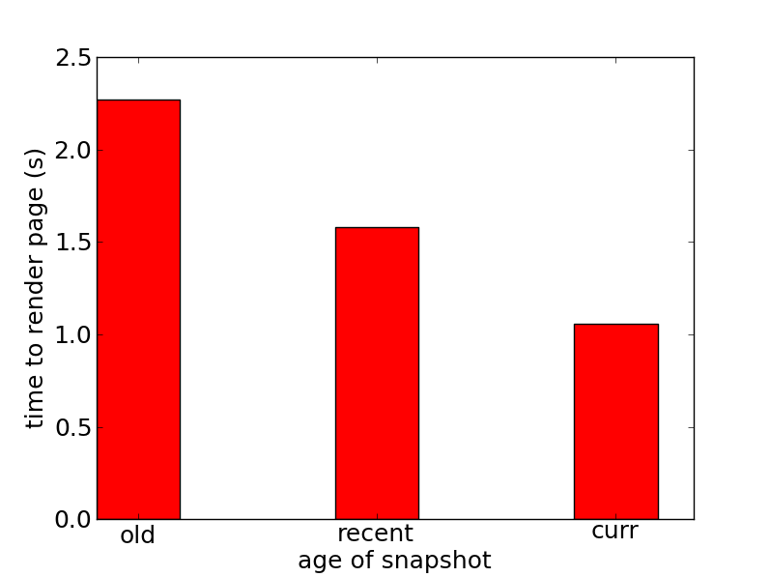
Time Travel Databases for the Web Programmer
Example Code
Charu Jain Ross Shaull Liuba Shrira
Brandeis University Brandeis University Brandeis University
jain.charu30@gmail.com rshaull@cs.brandeis.edu liuba@cs.brandeis.edu
Our web framework: Django
Code fragment with three queries
Results rendered to web
Time travel in data-driven applications
Past states of data hold valuable information that developers want to use in their applications
We have developed an architecture for a time traveling database, Retro, but how to bring Retro semantics to the data model in a web application?
What
Django is a Python-based web framework using the Model-view-controller paradigm
curr = filter(status__equals=form['s'])
mid = filter(status__equals=form['s']) .as_of(one week ago)
old= filter(status__equals=form['s']) .as_of(two weeks ago)
Why
Django is a popular and stable framework
How
Extend the data model to support as_of and snapshot_now when querying a Retro DB
Database access in Django
Django uses object-relational mapping (ORM); developers write models for their database tables, from which Python objects that can perform database queries and updates are generated
Back-end adapters generate database-specific code
Query results are represented by result sets, which are evaluated lazily
The developer can use the result sets curr, mid, and old in the standard Django way to render results to a web page
Vision
Alice 50000
Bob 20000
Cathy 35000
Developers produce data-driven web applications using web frameworks
/salaries
Performance evaluation
Alice 45000
Cathy 33000
Zaphod 60000
Overhead in Hot Cache
Searches a small table and sums filtered rows
Overhead imposed by Retro from indirect access to snapshot pages
Costs less when snapshot shares pages with current state
Entire snapshot on snapshot disk
/salaries/2001
The same code that runs in the current state can be executed as of a snapshot without added complexity
/salaries/trends
Programming Model
New code can combine results from multiple snapshots for anomaly detection, trend analysis, visualization
Original Django code
Retro extension
Time Travel with Retro
results = MyModel.filter(…).as_of(snapshot_id)
Overhead breakdown
Modifications to Django itself have negligible overhead
Retro overhead in the database is due to added indirection and searching snapshot metadata in the database
Retro is a layering-based approach to adding efficient time travel over snapshots inside an existing database system
Developers use existing Django ORM language
"As of" result set transparently queries a snapshot
Access methods
Retro operates at the storage manager level
Reads marked "as of" a snapshot are indirected to old versions of pages
Writes are captured transparently and saved (if needed) for snapshots
MVCC and existing recovery are leveraged for good performance
Storage manager
System Architecture
Retro
Django
View
Page cache
Model
ORM
Retro
I/O costs in Retro
I/O dominates unless many queries access the same snapshot
Snapshot pages are declustered so snapshot I/O is more costly
Current state
Snapshots
Queries
Retro commands
Database
Applications using a Retro DB have two new commands:
Retro
snapshot_now : create a snapshot, return a snap_id
as_of(snap_id) : execute a read transaction "as of" the specified snapshot
Small Retro module is added to Django, enabling result sets to issue Retro commands to the database
Query generator is unmodified because Retro allows snapshots to be queried "like the current state"
Paper trail
Retro: Efficient Retrospection in Off-the-shelf Data Store. Ross Shaull and Liuba Shrira. In Progress.
Skippy. Ross Shaull and Liuba Shrira. SIGMOD 2008.

